Slide 1

CREDIT BANKRUPTCY

Slide 2

MODELS
Logistic Model
Linear Discriminant Analysis (LDA)
Quadratic Discriminant Analysis (QDA)
Regression Tree
K Nearest Neighbor (KNN)

Slide 3

DUMMY MEASURES
Number of Clients → 5000
Default Percentage → 8%
Loss Incurred if person defaults → $250,000
Profit per person → $25,000

Slide 4

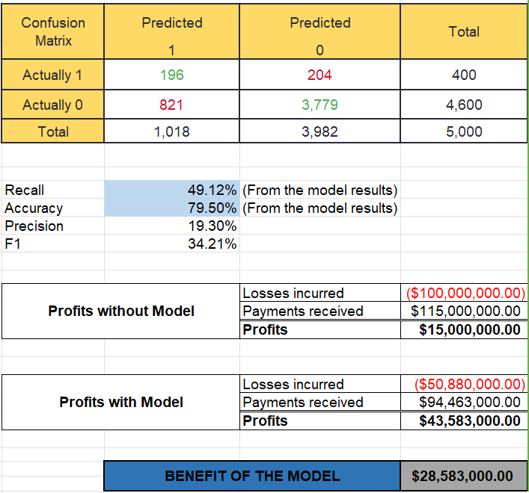
LOGISTIC MODEL
The best model in Logistic, provide the following:
Accuracy = 79.50%
Recall = 49.12%
Profits without model is
$15,000,000
Profits with model is
$43,583,000
BENEFIT OF THE MODEL
$28,583,000

Slide 5
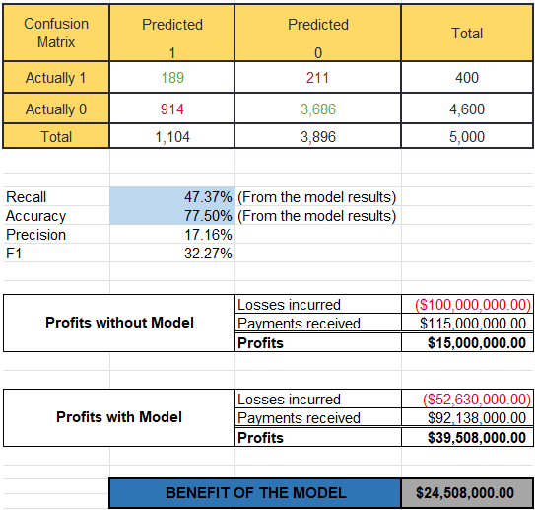
LINEAR DISCRIMINANT ANALYSIS (LDA)
The best model in LDA, provide the following:
Accuracy = 77.50%
Recall = 47.37%
Profits without model is
$15,000,000
Profits with model is
$39,508,000
BENEFIT OF THE MODEL
$24,508,000

Slide 6

QUADRATIC DISCRIMINANT ANALYSIS (QDA)
The best model in QDA, provide the following:
Accuracy = 72.50%
Recall = 61.40%
Profits without model is
$15,000,000
Profits with model is
$45,885,000
BENEFIT OF THE MODEL
$30,885,000

Slide 7

REGRESSION TREE
The best model in Regression Tree, provide the following:
Accuracy = 78.00%
Recall = 43.86%
Profits without model is
$15,000,000
Profits with model is
$36,974,000
BENEFIT OF THE MODEL
$21,974,000

Slide 8

K NEAREST NEIGHBOR (KNN)
The best model in KNN, provide the following:
Accuracy = 75.00%
Recall = 38.60%
Profits without model is
$15,000,000
Profits with model is
$28,490,000
BENEFIT OF THE MODEL
$13,490,000

Slide 9
DECISION TREE
DOUBLE CLICK ME
The PDF provides the decision tree along with the probabilities of defaulting.

Slide 10

CONCLUSION
The best model in terms of Profit is QDA.
The best model in terms of Accuracy is Logistic Model.
The best model in terms of Recall is QDA.

